Slide 1
Gene Annotation and GO
SPH 247
Statistical Analysis of
Laboratory Data

Slide 2
Slide Sources
www.geneontology.org
Jane Lomax (EBI)
David Hill (MGI)
Pascale Gaudet (dictyBase)
Stacia Engel (SGD)
Rama Balakrishnan (SGD)

Slide 3
The Gene Ontologies
A Common Language for Annotation of Genes from
Yeast, Flies and Mice
…and Plants and Worms
…and Humans
…and anything else!

Slide 4
Gene Ontology Objectives
GO represents categories used to classify specific parts of our biological knowledge:
Biological Process
Molecular Function
Cellular Component
GO develops a common language applicable to any organism
GO terms can be used to annotate gene products from any species, allowing comparison of information across species
Notes:
GO is the designation of a project as well as the product of the project.
Starting with the cellular level, we are not distinguishing cell types, organs,
etc.
Gene Ontology is a collaboration between the fly (FlyBase), mouse (MGD) genome databases, and yeast (SGD). All three groups had started independent projects to produce controlled vocabularies for the biology of their organisms.
You will all be familiar with hierarchical system to classify enzymes (EC) or functions (YPD, SwissPROT, MIPS, …).
We have divided our project into the creation of three ontologies. These are not necessarily hierarchical rather they can be a network of associations -- a directed acyclic graph (DAG).
Process: cell cycle, nutrient transport, behavior,
Function: alcohol dehydrogenase,
Cellular Location: organelle, protein complex, subcellular compartment

Slide 5
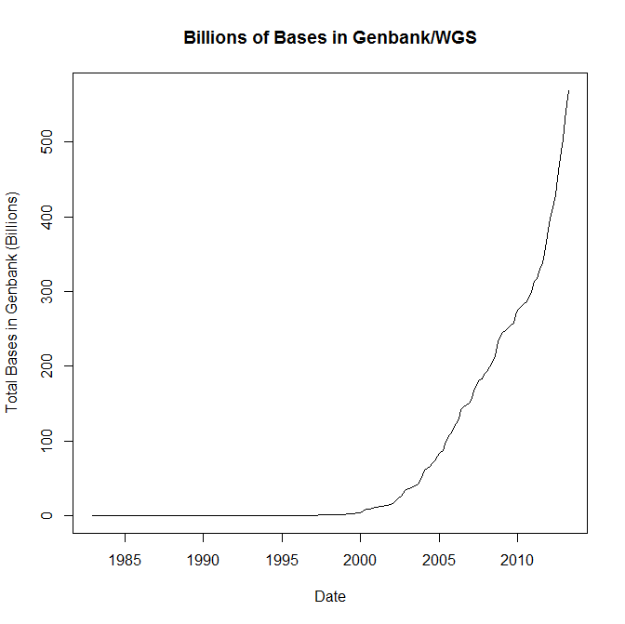
Expansion of Sequence Info

Slide 6
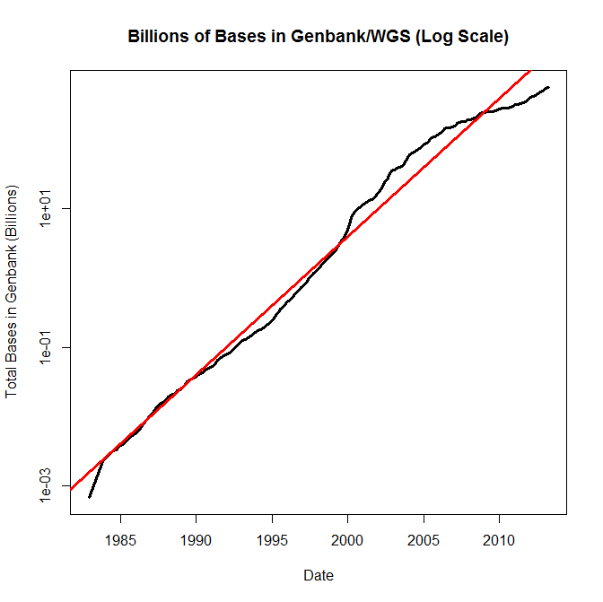
Expansion of Sequence Info

Slide 7
Entering the Genome Sequencing Era
Eukaryotic Genome Sequences Year Genome # Genes
Size (Mb)
Yeast (S. cerevisiae) 1996 12 6,000
Worm (C. elegans) 1998 97 19,100
Fly (D. melanogaster) 2000 120 13,600
Plant (A. thaliana) 2001 125 25,500
Human (H. sapiens, 1st Draft) 2001 ~3000 ~35,000

Slide 8
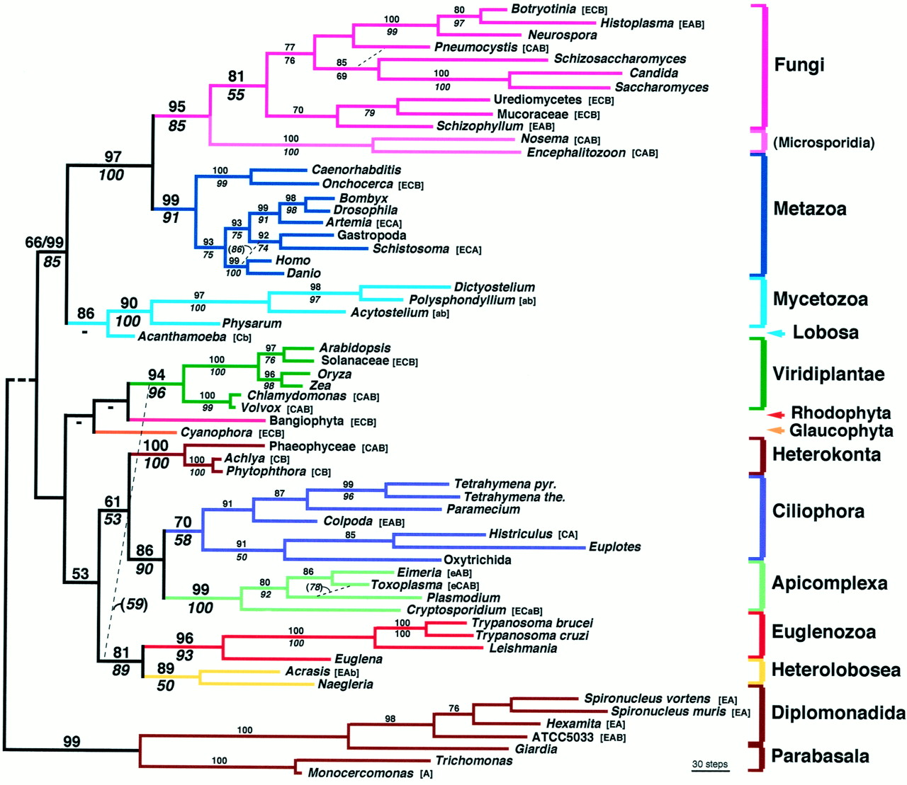
Baldauf et al. (2000)
Science 290:972

Slide 9
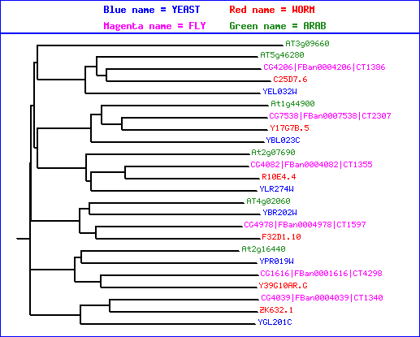
Comparison of sequences from 4 organisms
MCM3
MCM2
CDC46/MCM5
CDC47/MCM7
CDC54/MCM4
MCM6
These proteins form a hexamer in the species that have been examined

Slide 10
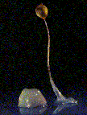
http://www.geneontology.org/

Slide 11
Outline of Topics
Introduction to the Gene Ontologies (GO)
Annotations to GO terms
GO Tools
Applications of GO

Slide 12
What is an Ontology? (from OED)
1721 BAILEY, Ontology, an Account of being in the Abstract. 1733 (title) A Brief Scheme of Ontology or the Science of Being in General. a1832 BENTHAM Fragm. Ontol. Wks. 1843 VIII. 195 The field of ontology, or as it may otherwise be termed, the field of supremely abstract entities, is a yet untrodden labyrinth. 1884 BOSANQUET tr. Lotze's Metaph. 22 Ontology..as a doctrine of the being and relations of all reality, had precedence given to it over Cosmology and Psychology, the two branches of enquiry which follow the reality into its opposite distinctive forms.

Slide 13
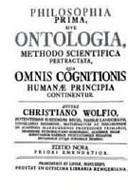
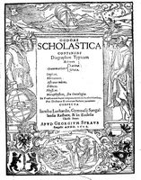
What is Ontology?
1606
1700s
Dictionary:A branch of metaphysics concerned with the nature and relations of being.
Barry Smith:The science of what is, of the kinds and structures of objects, properties, events, processes and relations in every area of reality.

Slide 14
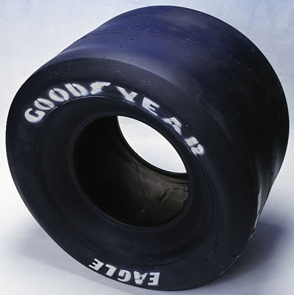
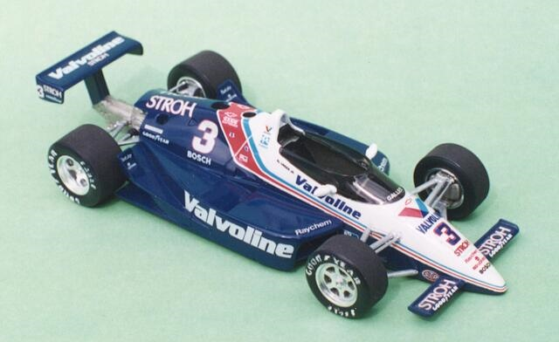
So what does that mean?
From a practical view, ontology is the representation of something we know about. “Ontologies" consist of a representation of things, that are detectable or directly observable, and the relationships between those things.
is part of

Slide 15
Sriniga Srinivasan, Chief Ontologist, Yahoo!
The ontology. Dividing human knowledge into a clean set of categories is a lot like trying to figure out where to find that suspenseful black comedy at your corner video store. Questions inevitably come up, like are Movies part of Art or Entertainment? (Yahoo! lists them under the latter.) -Wired Magazine, May 1996

Slide 16
The 3 Gene Ontologies
Molecular Function = elemental activity/task
the tasks performed by individual gene products; examples are carbohydrate binding and ATPase activity
Biological Process = biological goal or objective
broad biological goals, such as mitosis or purine metabolism, that are accomplished by ordered assemblies of molecular functions
Cellular Component = location or complex
subcellular structures, locations, and macromolecular complexes; examples include nucleus, telomere, and RNA polymerase II holoenzyme
Notes:
GO is the designation of a project as well as the product of the project.
Starting with the cellular level, we are not distinguishing cell types, organs,
etc.
Gene Ontology is a collaboration between the fly (FlyBase), mouse (MGD) genome databases, and yeast (SGD). All three groups had started independent projects to produce controlled vocabularies for the biology of their organisms.
You will all be familiar with hierarchical system to classify enzymes (EC) or functions (YPD, SwissPROT, MIPS, …).
We have divided our project into the creation of three ontologies. These are not necessarily hierarchical rather they can be a network of associations -- a directed acyclic graph (DAG).
Process: cell cycle, nutrient transport, behavior,
Function: alcohol dehydrogenase,
Cellular Location: organelle, protein complex, subcellular compartment

Slide 17
Example: Gene Product = hammer
Function (what) Process (why)
Drive nail (into wood) Carpentry
Drive stake (into soil) Gardening
Smash roach Pest Control
Clown’s juggling object Entertainment
Notes:
Stakes into vampires
Nails into wood is reversible with this model of hammer, you can remove the nails with the claw.
Cytoskeletal structural protein
Storage protein
WHY -- Process
WHAT -- Function

Slide 18
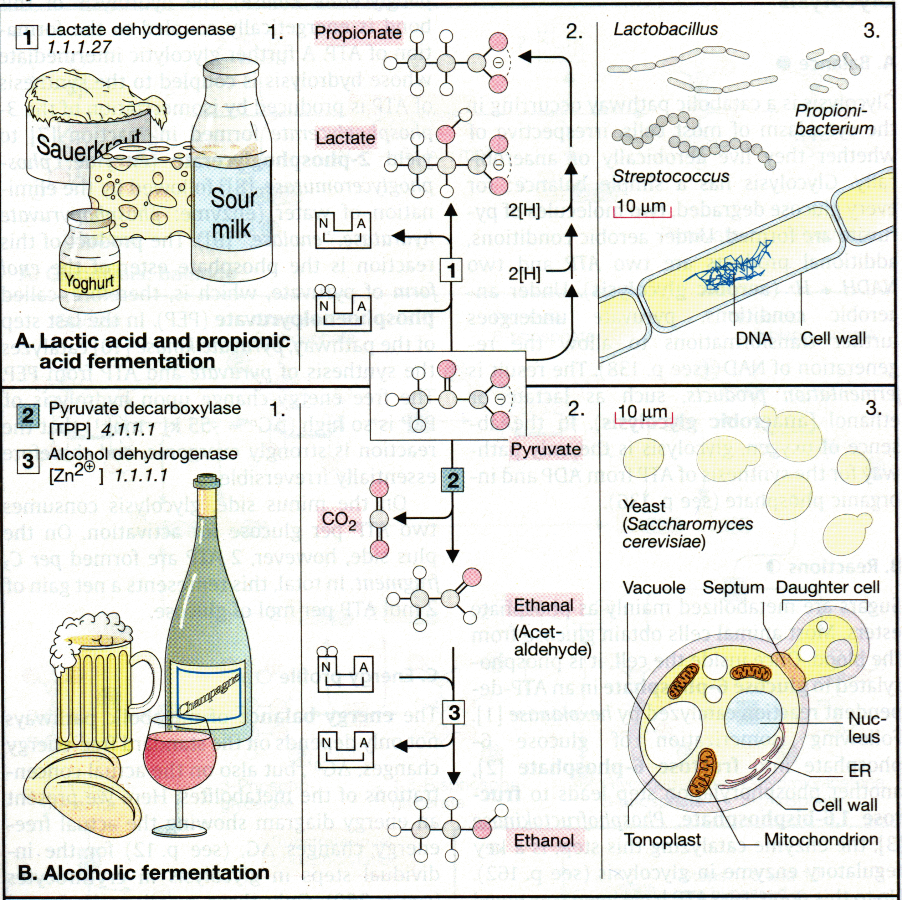
Biological Examples
Biological Process
Molecular Function
Biological Process
Molecular Function
Cellular Component
Cellular Component

Slide 19
Terms, Definitions, IDs
term: MAPKKK cascade (mating sensu Saccharomyces)
goid: GO:0007244
definition: OBSOLETE. MAPKKK cascade involved in transduction of mating pheromone signal, as described in Saccharomyces.
definition_reference: PMID:9561267
comment: This term was made obsolete because it is a gene product specific term. To update annotations, use the biological process term 'signal transduction during conjugation with cellular fusion ; GO:0000750'.
definition: MAPKKK cascade involved in transduction of mating pheromone signal, as described in Saccharomyces

Slide 20
Ontology
Includes:
A vocabulary of terms (names for concepts)
Definitions
Defined logical relationships to each other
Notes:
An ontology has 3 components:
1. the vocabulary terms
2. the term definitions
3. the relationships between the terms
I am going to talk briefly about the relationships between the terms

Slide 21
chromosome
organelle
nucleus
[other organelles]
[other types of chromosomes]
nuclear chromosome
Notes:
The relationships between GO terms are represented by a graph. Here is an example, you can see that "nucleus" is related to "organelle", chromosome is related to "nuclear chromosome" and "nuclear chromosome" is related to both "nucleus" and "chromosome".

Slide 22
Ontology Structure
Ontologies can be represented as graphs, where the nodes are connected by edges
Nodes = terms in the ontology
Edges = relationships between the concepts
node
edge
node
node
Notes:
More formally, the ontology is represented as a graph with concepts being nodes and the concepts being connected by lines.

Slide 23
Parent-Child Relationships
Chromosome
Cytoplasmic
chromosome
Mitochondrial
chromosome
Nuclear
chromosome
Plastid
chromosome
A child is
a subset or instances of
a parent’s elements
Notes:
The way we refer to terms relative to each other is as "parents" and "children", where a child is a subset of a parent's elements.
Here as an example we have chromosome and several of its children

Slide 24
Ontology Structure
The Gene Ontology is structured as a hierarchical directed acyclic graph (DAG)
Terms can have more than one parent and zero, one or more children
Terms are linked by two relationships
is-a
part-of
is_a
part_of
Notes:
The Gene Ontology is represented by a graph type called "acyclic graph" where each terms can have one or more parents and 0, 1 or more children
The two relationships that we have in the Gene Ontology are "is_a" and "part_of"
IS_A means that the child terms is an instance or an example of its parent
PART_OF means that the child is a part of or a subset of its parent

Slide 25
Directed Acyclic Graph (DAG)
chromosome
organelle
nucleus
[other organelles]
[other types of chromosomes]
nuclear chromosome
is-a
part-of
Notes:
Going back to the nuclear chromosome example, the nuclear chromosome has two parents "chromosome" and "nucleus"; it is has a "is_a" relationship with the "chromosome", since the nuclear chromosome is a type of chromosome, and it has a part_of relationship with nucleus, since it is a part of the nucleus.
You might also notice that "nucleus" is a kind of "organelle"

Slide 26
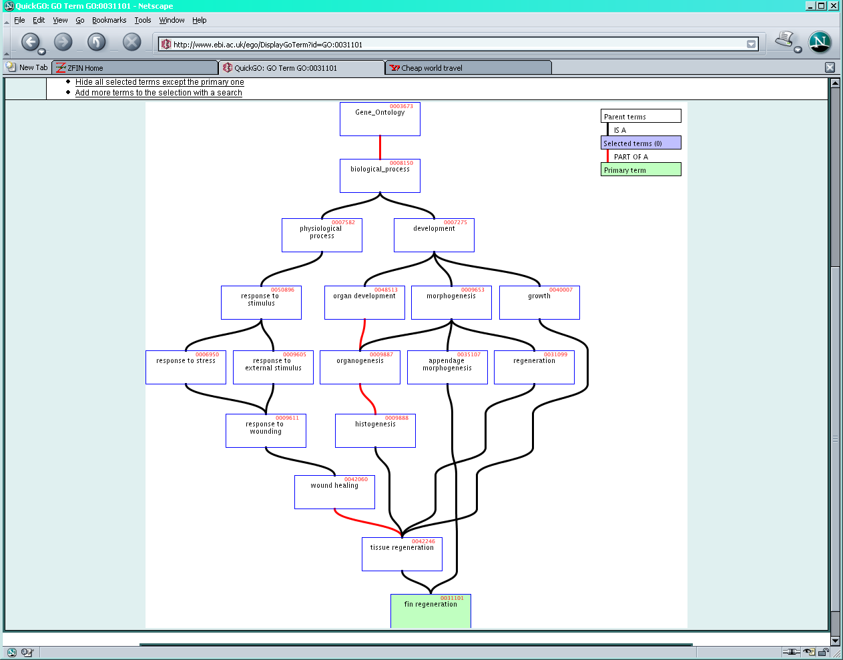
http://www.ebi.ac.uk/ego
Notes:
This is a more complex example, to give you an idea of what you might expect to see.
Therefore, the graph itself provides a lot of information about a term.

Slide 27
Evidence Codes for GO Annotations
http://www.geneontology.org/GO.evidence.shtml

Slide 28
Evidence codes
Indicate the type of evidence in the cited source* that supports the association between the gene product and the GO term
*capturing information

Slide 29
Types of evidence codes
Experimental codes – EXP, IDA, IMP, IGI, IPI, IEP
Computational codes - ISS, ISO, ISA, IGC, IBA, IBD, IKR, IRD, RCA, IEA
Author statement - TAS, NAS
Other codes - IC, ND

Slide 30
Experimental Evidence Codes
Inferred from Experiment (EXP)
Inferred from Direct Assay (IDA)
Inferred from Physical Interaction (IPI)
Inferred from Mutant Phenotype (IMP)
Inferred from Genetic Interaction (IGI)
Inferred from Expression Pattern (IEP)

Slide 31
Computational Evidence Codes
Inferred from Sequence or structural Similarity (ISS)
Inferred from Sequence Orthology (ISO)
Inferred from Sequence (ISA)
Inferred from Sequence Model (ISM)
Inferred from Genomic Context (IGC)
Inferred from Biological aspect of Ancestor (IBA)
Inferred from Biological aspect of Descendant (IBD)
Inferred from Key Residues (IKR)
Inferred from Rapid Divergence(IRD)
inferred from Reviewed Computational Analysis (RCA)

Slide 32
Author Statement Codes
Traceable Author Statement (TAS)
Non-traceable Author Statement (NAS)
Curatorial Statement Evidence Codes
Inferred by Curator (IC)
No biological Data available (ND)
Automatically Assigned Evidence Codes
Inferred from Electronic Annotation (IEA)

Slide 33
IDA Inferred from Direct Assay
direct assay for the function, process, or component indicated by the GO term
Enzyme assays
In vitro reconstitution (e.g. transcription)
Immunofluorescence (for cellular component)
Cell fractionation (for cellular component)

Slide 34
IMP Inferred from Mutant Phenotype
variations or changes such as mutations or abnormal levels of a single gene product
Gene/protein mutation
Deletion mutant
RNAi experiments
Specific protein inhibitors
Allelic variation

Slide 35
IGI Inferred from Genetic Interaction
Any combination of alterations in the sequence or expression of more than one gene or gene product
Traditional genetic screens
- Suppressors, synthetic lethals
Functional complementation
Rescue experiments
An entry in the ‘with’ column is recommended

Slide 36
IPI Inferred from Physical Interaction
Any physical interaction between a gene product and another molecule, ion, or complex
2-hybrid interactions
Co-purification
Co-immunoprecipitation
Protein binding experiments
An entry in the ‘with’ column is recommended

Slide 37
IEP Inferred from Expression Pattern
Timing or location of expression of a gene
Transcript levels
Northerns, microarray, RNA-Seq
Exercise caution when interpreting expression results

Slide 38
ISS Inferred from Sequence or structural Similarity
Sequence alignment, structure comparison, or evaluation of sequence features such as composition
Sequence similarity
Recognized domains/overall architecture of protein
An entry in the ‘with’ column is recommended

Slide 39
RCA Inferred from Reviewed Computational Analysis
non-sequence-based computational method
large-scale experiments
genome-wide two-hybrid
genome-wide synthetic interactions
integration of large-scale datasets of several types
text-based computation (text mining)

Slide 40
IGC Inferred from Genomic Context
Chromosomal position
Most often used for Bacteria - operons
Direct evidence for a gene being involved in a process is minimal, but for surrounding genes in the operon, the evidence is well-established

Slide 41
IEA Inferred from Electronic Annotation
depend directly on computation or automated transfer of annotations from a database
Hits from BLAST searches
InterPro2GO mappings
No manual checking
Entry in ‘with’ column is allowed (ex. sequence ID)

Slide 42
TAS Traceable Author Statement
publication used to support an annotation doesn't show the evidence
Review article
Would be better to track down cited reference and use an experimental code

Slide 43
NAS Non-traceable Author Statement
Statements in a paper that cannot be traced to another publication

Slide 44
ND No biological Data available
Can find no information supporting an annotation to any term
Indicate that a curator has looked for info but found nothing
Place holder
Date

Slide 45
IC Inferred by Curator
annotation is not supported by evidence, but can be reasonably inferred from other GO annotations for which evidence is available
ex. evidence = transcription factor (function)
IC = nucleus (component)

Slide 46
Choosing the correct evidence code
Ask yourself:
What is the experiment that was done?

Slide 47
http://www.geneontology.org/GO.evidence.shtml

Slide 48
Using the Gene Ontology (GO) for Expression Analysis

Slide 49
What is the Gene Ontology?
Set of biological phrases (terms) which are applied to genes:
protein kinase
apoptosis
membrane

Slide 50
What is the Gene Ontology?
Genes are linked, or associated, with GO terms by trained curators at genome databases
known as ‘gene associations’ or GO annotations
Some GO annotations created automatically
Notes:
These GO phrases, or TERMS are linked to genes by expert curators at genome databses.
will talk about in more detail later

Slide 51
GO annotations
GO database
gene -> GO term
associated genes
genome and protein databases

Slide 52
What is the Gene Ontology?
Allows biologists to make inferences across large numbers of genes without researching each one individually

Slide 53
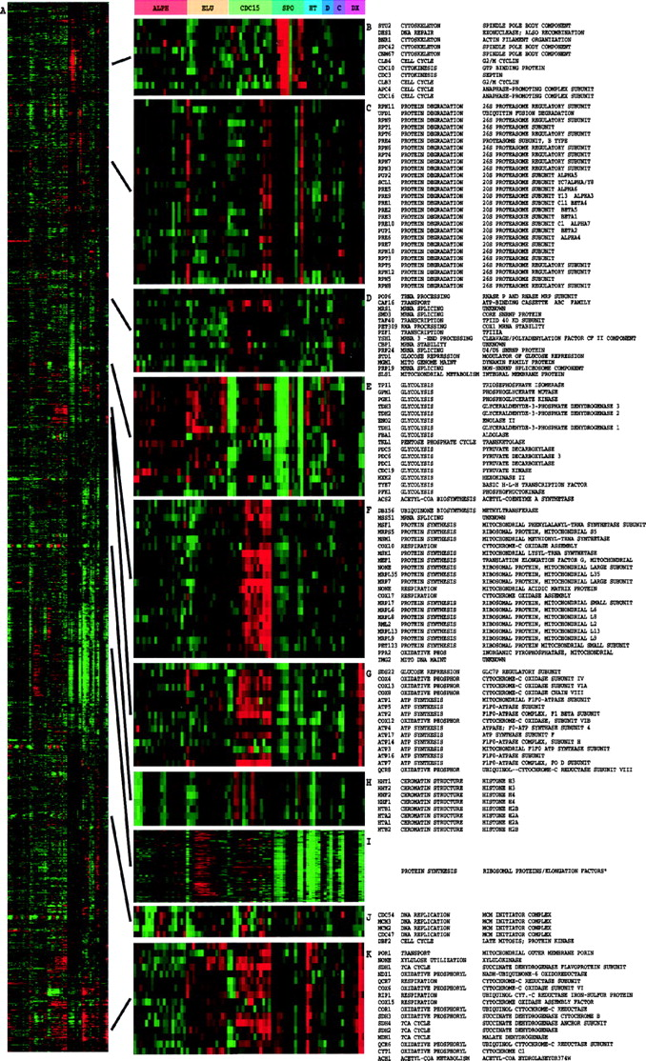
Eisen, Michael B. et al. (1998) Proc. Natl. Acad. Sci. USA 95, 14863-14868
Copyright ©1998 by the National Academy of Sciences

Slide 54
GO structure
GO isn’t just a flat list of biological terms
terms are related within a hierarchy
Notes:
Two arrangements for DNA replication

Slide 55
GO structure
gene A

Slide 56
GO structure
This means genes can be grouped according to user-defined levels
Allows broad overview of gene set or genome

Slide 57
How does GO work?
GO is species independent
some terms, especially lower-level, detailed terms may be specific to a certain group
e.g. photosynthesis
But when collapsed up to the higher levels, terms are not dependent on species

Slide 58
How does GO work?
What does the gene product do?
Where and when does it act?
Why does it perform these activities?
What information might we want to capture about a gene product?

Slide 59
GO structure
GO terms divided into three parts:
cellular component
molecular function
biological process

Slide 60
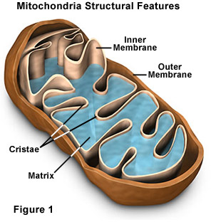
Cellular Component
where a gene product acts

Slide 61
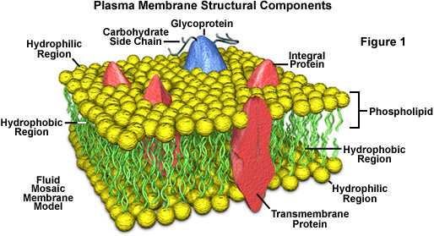
Cellular Component

Slide 62
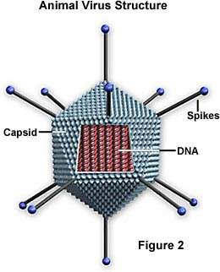
Cellular Component

Slide 63
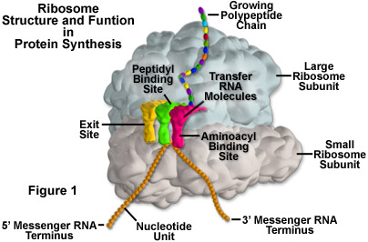
Cellular Component
Enzyme complexes in the component ontology refer to places, not activities.

Slide 64
Molecular Function
activities or “jobs” of a gene product
glucose-6-phosphate isomerase activity

Slide 65
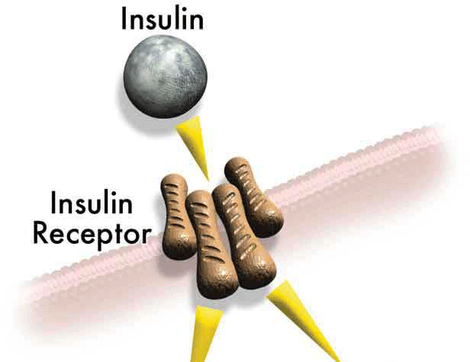
Molecular Function
insulin binding insulin receptor activity

Slide 66
Molecular Function
A gene product may have several functions; a function term refers to a single reaction or activity, not a gene product.
Sets of functions make up a biological process.

Slide 67
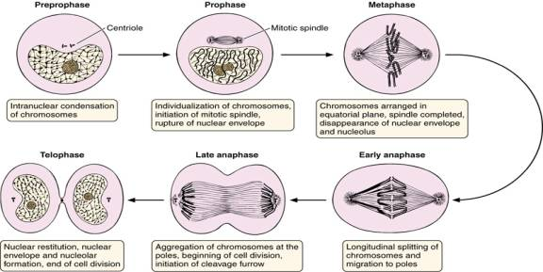
Biological Process
a commonly recognized series of events
cell division

Slide 68
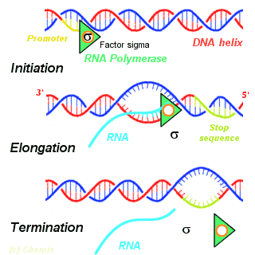
Biological Process
transcription

Slide 69
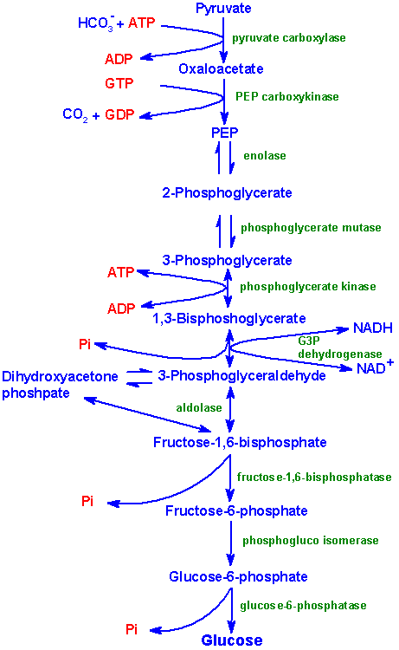
Biological Process
regulation of gluconeogenesis

Slide 70
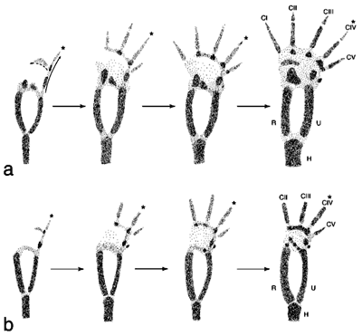
Biological Process
limb development

Slide 71
Ontology Structure
Terms are linked by two relationships
is-a 
part-of ➔

Slide 72
Ontology Structure
cell
membrane chloroplast
mitochondrial chloroplast
membrane membrane
is-a
part-of

Slide 73
Ontology Structure
Ontologies are structured as a hierarchical directed acyclic graph (DAG)
Terms can have more than one parent and zero, one or more children

Slide 74
Ontology Structure
Directed Acyclic Graph (DAG) - multiple parentage allowed
cell
membrane chloroplast
mitochondrial chloroplast
membrane membrane

Slide 75
Anatomy of a GO term
id: GO:0006094
name: gluconeogenesis
namespace: process
def: The formation of glucose from
noncarbohydrate precursors, such as
pyruvate, amino acids and glycerol.
[http://cancerweb.ncl.ac.uk/omd/index.html]
exact_synonym: glucose biosynthesis
xref_analog: MetaCyc:GLUCONEO-PWY
is_a: GO:0006006
is_a: GO:0006092
unique GO ID
term name
ontology
definition
synonym
database ref
parentage
Notes:
17800 terms in three ontologies
94% of terms defined

Slide 76
GO tools
GO resources are freely available to anyone to use without restriction
Includes the ontologies, gene associations and tools developed by GO
Other groups have used GO to create tools for many purposes:
http://www.geneontology.org/GO.tools
http://neurolex.org/wiki/Category:Resource:Gene_Ontology_Tools

Slide 77
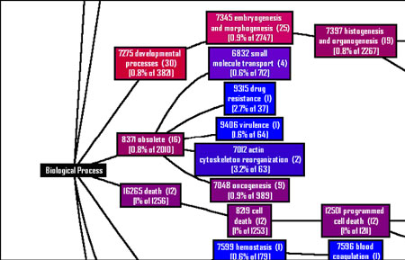
GO tools
Affymetrix also provide a Gene Ontology Mining Tool as part of their NetAffx™ Analysis Center which returns GO terms for probe sets

Slide 78
GO tools
Many tools exist that use GO to find common biological functions from a list of genes:
http://neurolex.org/wiki/Category:Resource:Gene_Ontology_Tools
Notes:
insert slides from sorin’s talk

Slide 79
GO tools
Most of these tools work in a similar way:
input a gene list and a subset of ‘interesting’ genes
tool shows which GO categories have most interesting genes associated with them i.e. which categories are ‘enriched’ for interesting genes
tool provides a statistical measure to determine whether enrichment is significant

Slide 80
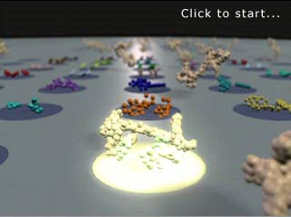
Microarray process
Treat samples
Collect mRNA
Label
Hybridize
Scan
Normalize
Select differentially expressed genes
Understand the biological phenomena involved
Notes:
So this is a typical process that you’d use to collect data from your microarray
Just like that - makes it look very easy!
So for a certain set of conditions, you have a set of differentially regualted genes and what you really want to know about is the underlying biological processes involved.

Slide 81
Traditional analysis
Gene 1
Apoptosis
Cell-cell signaling
Protein phosphorylation
Mitosis
…
Gene 2
Growth control
Mitosis
Oncogenesis
Protein phosphorylation
…
Gene 3
Growth control
Mitosis
Oncogenesis
Protein phosphorylation
…
Gene 4
Nervous system
Pregnancy
Oncogenesis
Mitosis
…
Gene 100
Positive ctrl. of cell prolif
Mitosis
Oncogenesis
Glucose transport
…
Notes:
Typically, this is the way the analysis would have been done.
Taking your differentially regualted genes, you’d analyse them one by one - researching the what is known about that gene, and what processes it is involved in.

Slide 82
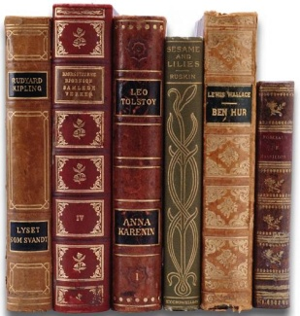
Traditional analysis
gene by gene basis
requires literature searching
time-consuming
Notes:
So this gene by gene approach has the major disadvantage that you have to delve into the literature yourself, which is obviously very time consuming.

Slide 83
Using GO annotations
But by using GO annotations, this work has already been done for you!
GO:0006915 : apoptosis
Notes:
But by using GO annotations, this work has already been done for you - someone has already sat down and associated a particular gene with a particular process…

Slide 84
Grouping by process
Mitosis
Gene 2
Gene 5
Gene45
Gene 7
Gene 35
…
Glucose transport
Gene 7
Gene 3
Gene 6
…
Apoptosis
Gene 1
Gene 53
Positive ctrl. of
cell prolif.
Gene 7
Gene 3
Gene 12
…
Growth
Gene 5
Gene 2
Gene 6
…
Notes:
So you have the ability to group your differentially regulated genes by process…

Slide 85
GO for microarray analysis
Annotations give ‘function’ label to genes
Ask meaningful questions of microarray data e.g.
genes involved in the same process, same/different expression patterns?
Notes:
GO and it’s annotations are useful in microarrays mainly for comparing gene expression patterns to gene function, allowing more meaningful interpretation of microarray data.

Slide 86
Using GO in practice
statistical measure
how likely your differentially regulated genes fall into that category by chance
mitosis – 80/100
apoptosis – 40/100
p. ctrl. cell prol. – 30/100
glucose transp. – 20/100
microarray
1000 genes
100 genes differentially expressed
experiment
Notes:
The better ones include an statistical measure of how likely your differentially regulated genes fall into that category by chance
So why is that necessary
So imagine you do a microarray with a 1000 genes, and you find that 100 are differentially regualted
And these are the GO processes that those differentially regualted genes fall into - it looks like mitosis is overrepresented….

Slide 87
Using GO in practice
However, when you look at the distribution of all genes on the microarray:
Process Genes on array # genes expected in occurred 100 random genes
mitosis 800/1000 80 80
apoptosis 400/1000 40 40
p. ctrl. cell prol. 100/1000 10 30 glucose transp. 50/1000 5 20
Notes:
you can see that 80% of them were involved in mitosis, so the number upregulated is what you’d expect by chance.
The category positive regulation of cell proliferation actually contains more differentially regualted genes than you would expect by chance
Need a statistical test e.g. Chi-squared to see if this overrepresentation or enrichment of a certain class is statistically significant.

Slide 88
AmiGO
Web application that reads from the GO Database (mySQL)
http://amigo.geneontology.org/cgi-bin/amigo/go.cgi
Allows us to
browse the ontologies
view annotations from various species
compare sequences (GOst)
Ontologies are loaded into the database from the gene_ontology.obo file
Annotations are loaded from the gene_association files submitted by the various annotating groups
Only ‘Non-IEA’ annotations are loaded
Notes:
As Suparna mentioned the GO project consists of two integral components- the ontologies and the annotations. The GO project provides controlled vocabularies in 3 aspects to describe gene products and the various annotating groups provide annotations (ie) use these terms to describe gene products. How can one view all this information in a meaningful way? Using AmiGO!
The GO project provides a cool web application called AmiGO to view

Slide 89
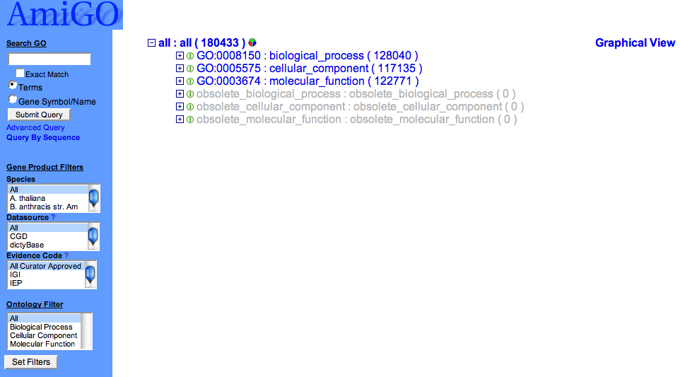
AmiGO http://www.godatabase.org
Node has children, can be clicked to view children

Slide 90
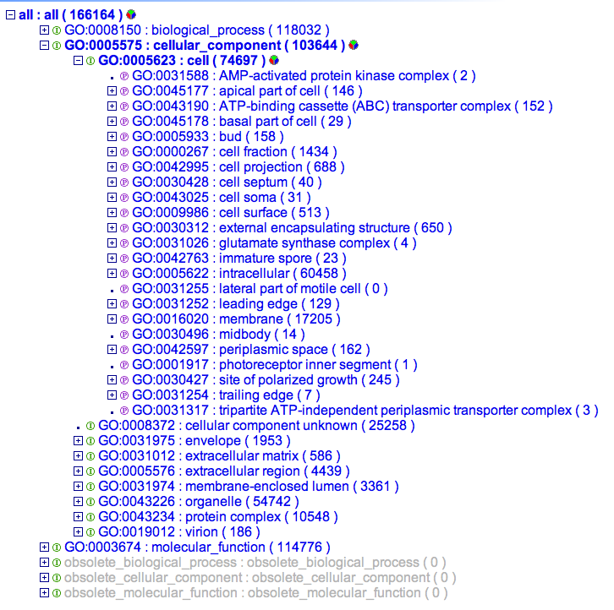
Some basics
Node has children, can be clicked to view children
Node has been opened, can be clicked to close
Leaf node or no children
Is_a relationship
Part_of relationship
pie chart summary of the numbers of gene products associated to any
immediate descendants of this term in the tree.

Slide 91
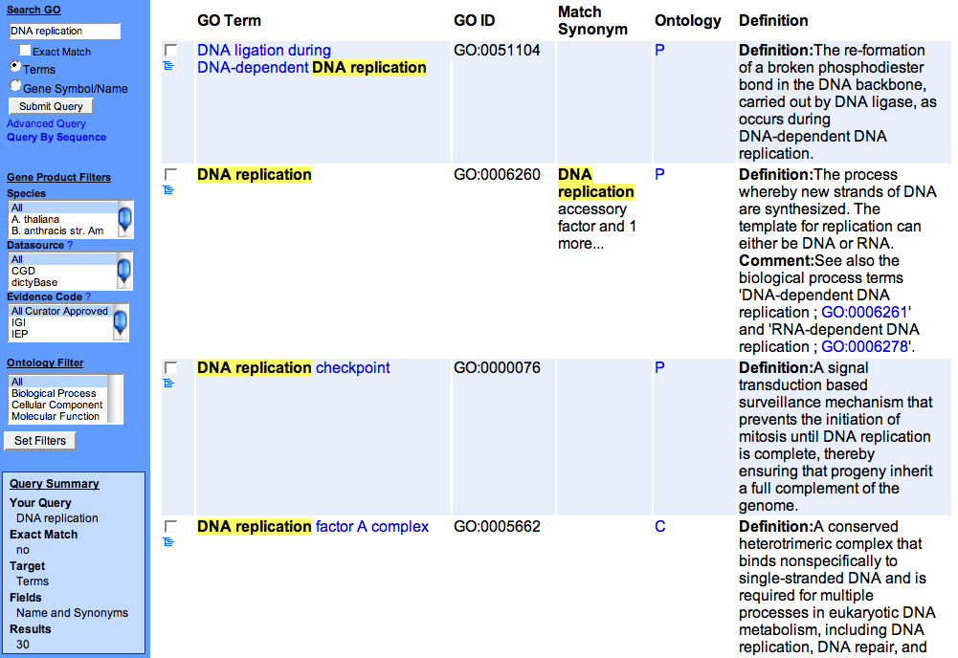
Searching the Ontologies

Slide 92
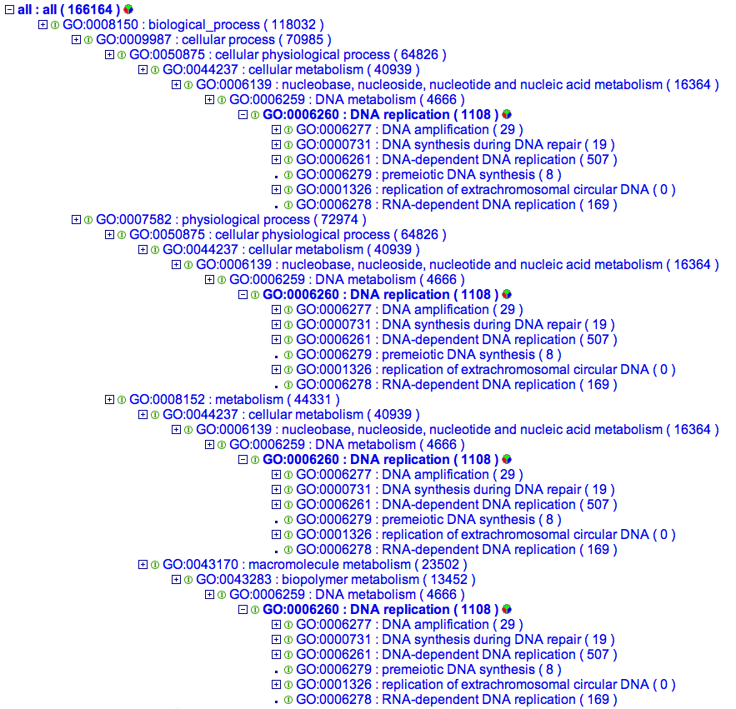
Term Tree View

Slide 93
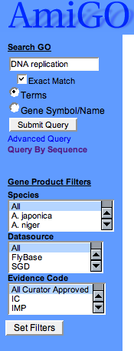
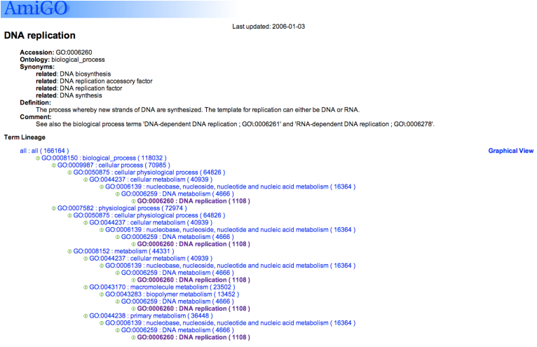
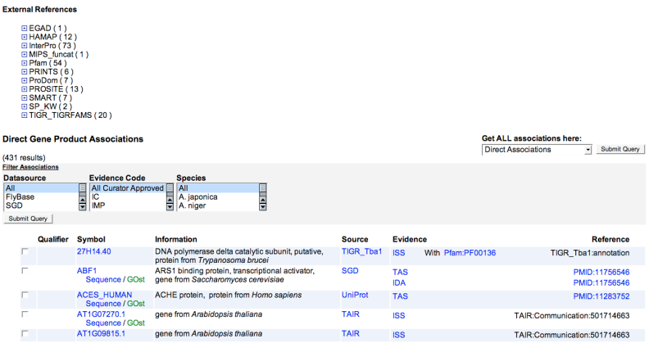
Click on the term name to view term details and annotations

Slide 94
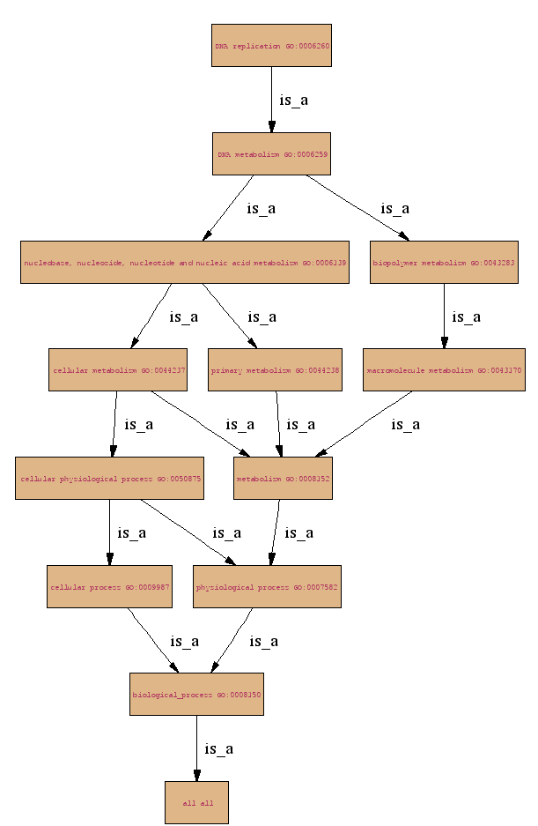
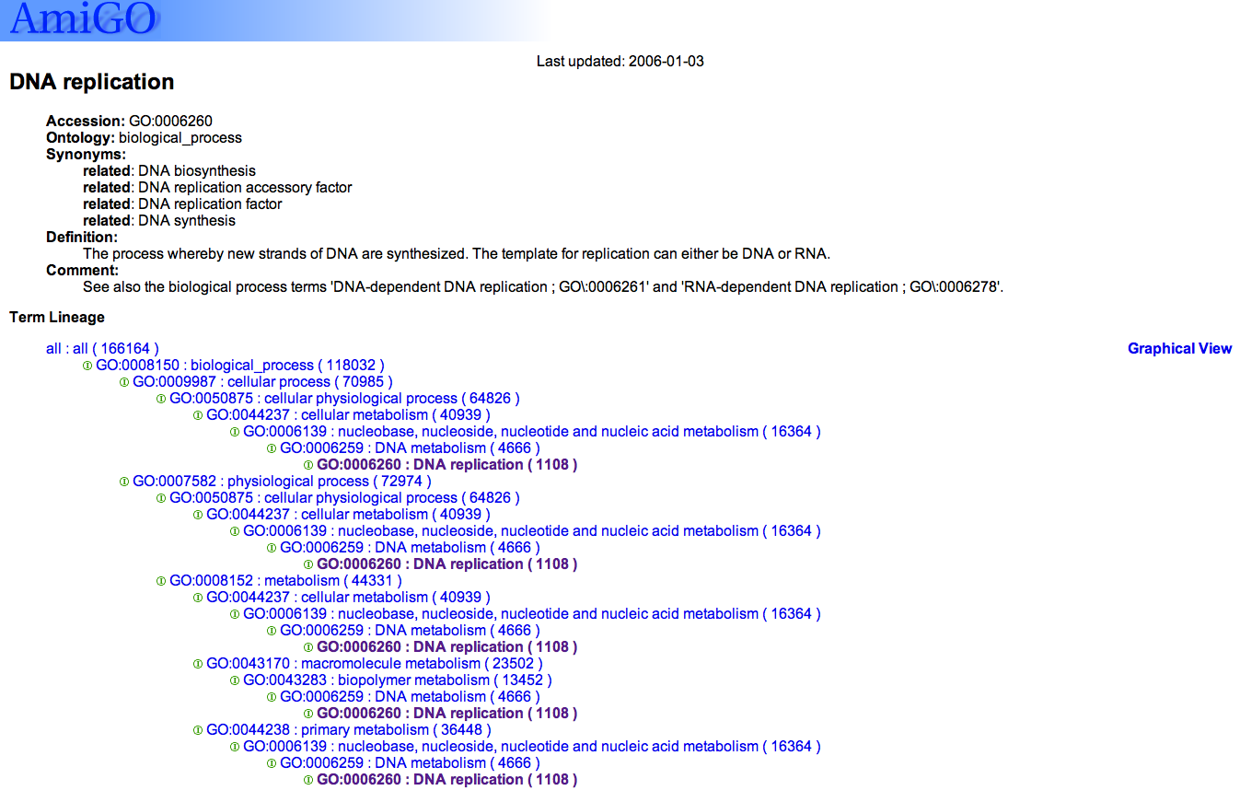
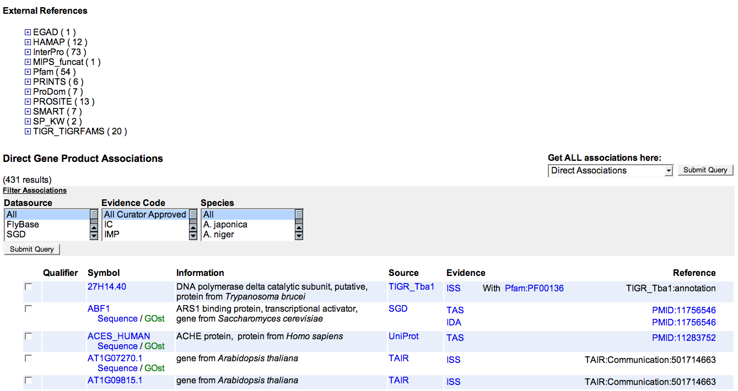
Term details
links to representations of this term in other databases
Annotations from various species

Slide 95
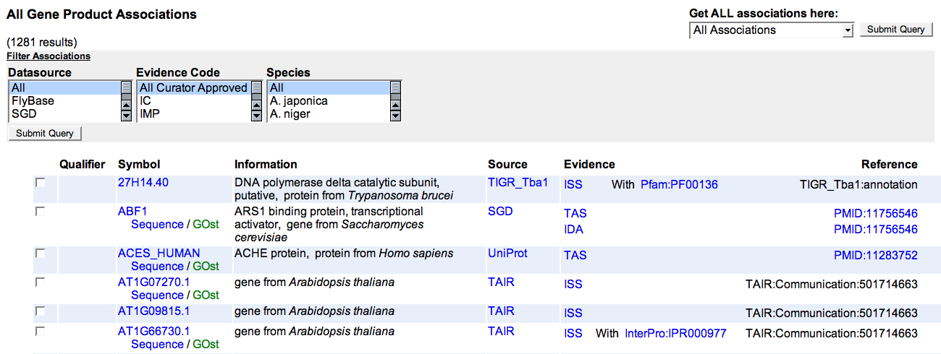
Annotations associated with a term
Annotation data are from the gene_associations file submitted by the annotating groups

Slide 96
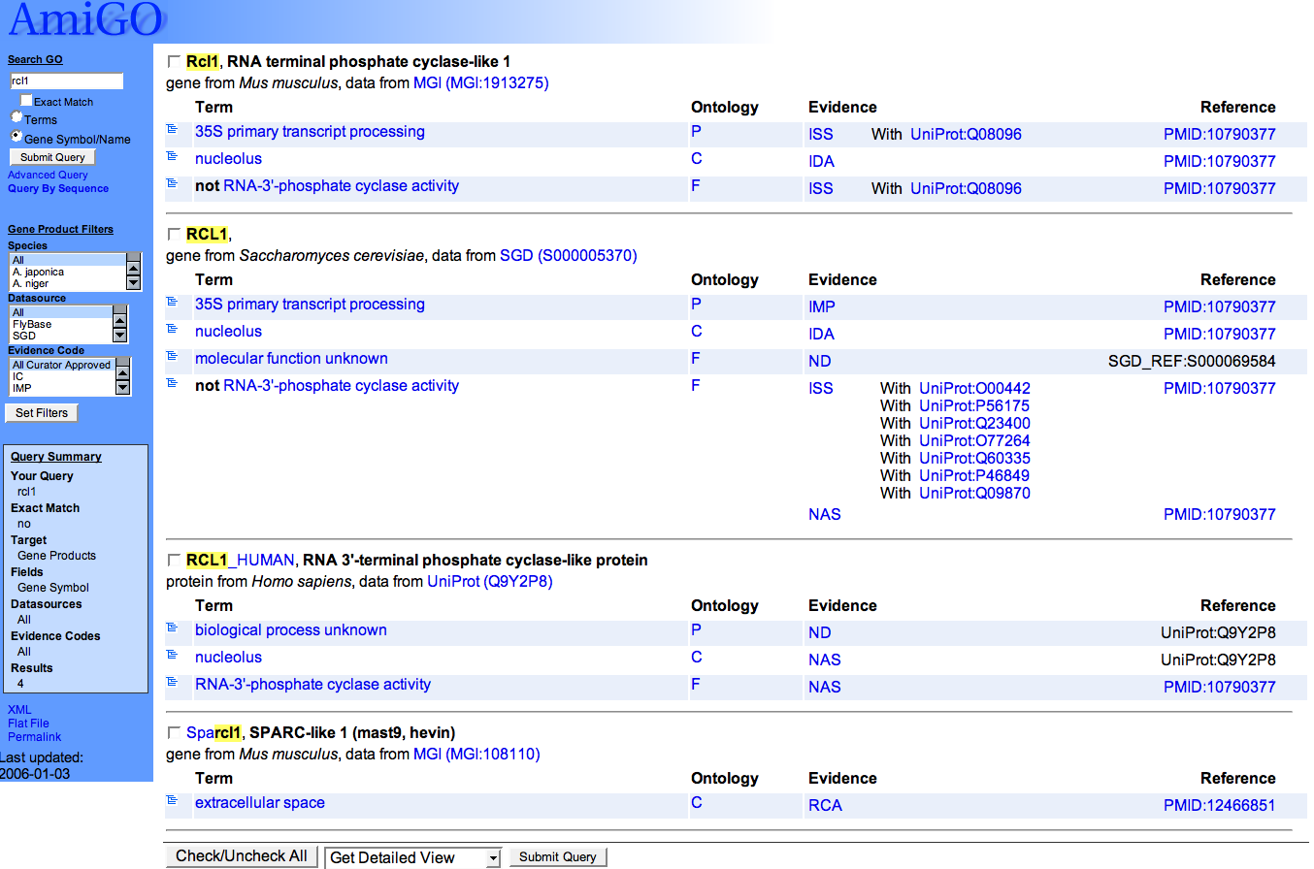
Searching by gene product name

Slide 97
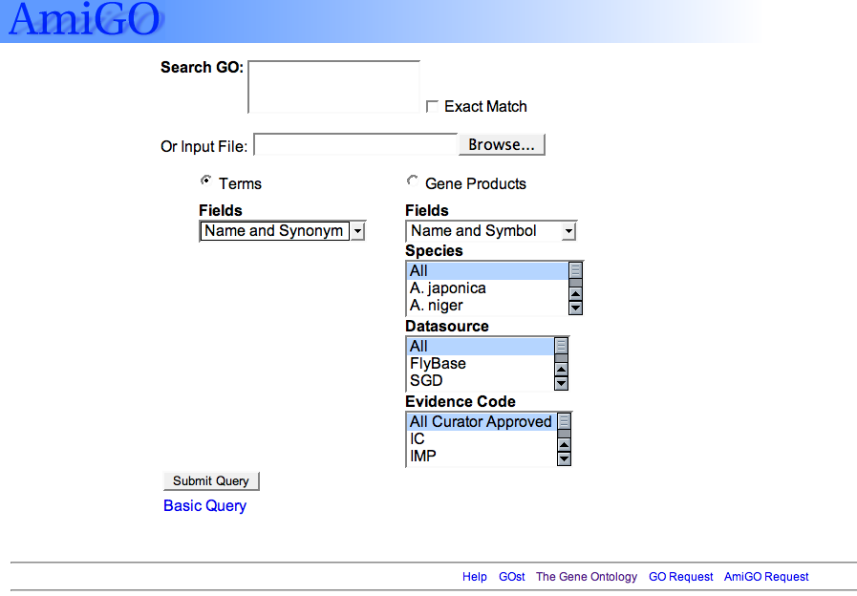
Advanced search

Slide 98
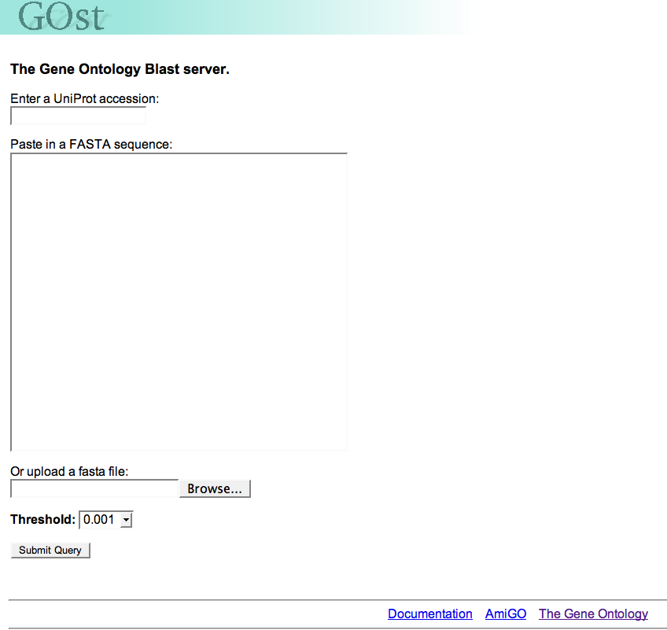
GOST-Gene Ontology blaST
Blast a protein sequence against all gene products that have a GO annotation
Can be accessed from the AmiGO entry page (front page)

Slide 99
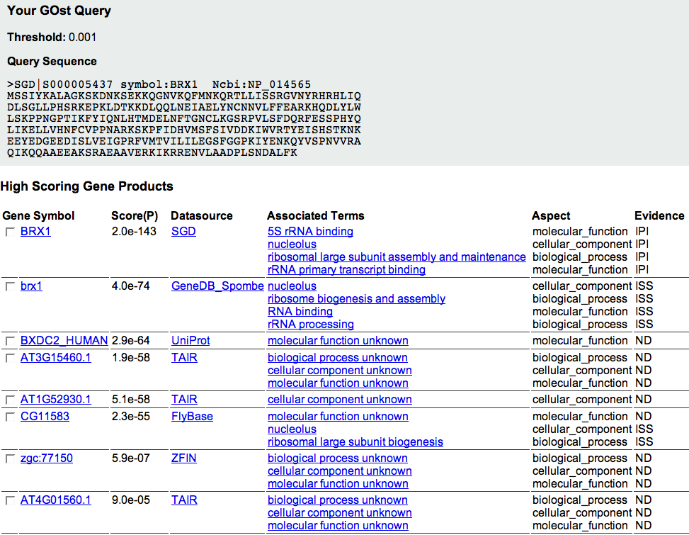
GOst can also be accessed from the annotations section

Slide 100
Analysis of Gene Expression Data
The usual sequence of events is to conduct an experiment in which biological samples under different conditions are analyzed for gene expression.
Then the data are analyzed to determine differentially expressed genes.
Then the results can be analyzed for biological relevance.

Slide 101
Biological
Knowledge
Expression
Experiment
Statistical
Analysis
Biological
Interpretation

Slide 102
The Missing Link
Biological
Knowledge
Expression
Experiment
Statistical
Analysis
Biological
Interpretation

Slide 103
Gene Set Enrichment Analysis (GSEA)
Given a set of genes (e.g., zinc finger proteins), this defines a set of probes on the array.
Order the probes by smallest to largest change (we use p-value, not fold change).
Define a cutoff for “significance” (e.g., FDR p-value < .10).
Are there more of the probes in the group than expected?

Slide 104
P-value
0.0947
 | Not in gene set | In gene Set | Total
Not significant | 30 91%/75% | 3 9%/38% | 33
Significant | 10 67%/25% | 5 33%/62% | 15
Total | 40 | 8 | 48

Slide 105
GSEA for all cutoffs
If one does GSEA for all possible cutoffs, and then takes the best result, this is equivalent to an easily performed statistical test called the Kolmogorov-Smirnov test for the genes in the set vs. the genes not in the set.
Programs on www.broad.mit.edu/gsea/
However this requires a single summary number for each gene, such as a p-value.

Slide 106
An Example Study
This study examined the effects of relatively low-dose radiation exposure in-vivo in humans with precisely calibrated dose.
Low LET ionizing radiation is a model of cellular toxicity in which the insult can be given at a single time point with no residual external toxic content as there would be for metals and many long-lived organics.

Slide 107
The study design
Men were treated for prostate cancer with daily fractions of 2 Gy for a total dose to the prostate of 74 Gy.
Parts of the abdomen outside the field were exposed to lower doses.
These could be precisely quantitated by computer simulation and direct measurements by MOSFETs.

Slide 108
A 3mm biopsy was taken of abdominal skin before the first exposure, then three more were taken three hours after the first exposure at sites with doses of 1, 10, and 100 cGy.
RNA was extracted and hybridized on Affymetrix HG U133 Plus 2.0 whole genome arrays.
The question asked was whether a particular gene had a linear dose response, or a response that was linear in (modified) log dose (0, 1, 10, 100 -> -1, 0, 1, 2).

Slide 109
Why is this difficult?
For a single patient, there are only 4 data points, so the statistical test is not very powerful.
With 54,675 probe sets, very apparently significant results can happen by chance, so the barrier for true significance is very high.
This happens in any small sized array study.

Slide 110
There are reasons to believe that there may be inter-individual variability in response to radiation.
This means that we may not be able to look for results that are highly consistent across individuals.
One aspect is the timing of transcriptional cascades.
Another is polymorphisms that lead to similar probes being differentially expressed, but not the same ones.

Slide 111
Gene 1
Gene1
Gene 2
3 Hours
Gene 2
Gene 3
Gene 3

Slide 112
The ToTS Method
For a gene group like zinc finger proteins, identify the probe sets that relate to that gene group.
ToTS = Test of Test Statistics

Slide 113
For each probe set, conduct a statistical test to try to show a linear dose reponse.
This yields a t-statistic, which may be positive or negative.
Conduct a statistical test on the group of t-statistics, testing the hypothesis that the average is zero, vs. leaning to up-regulation or leaning to down-regulation
This could be a t-test, but we used in this case the Wilcoxon test.

Slide 114
This can be done one patient at a time, but we can also accommodate inter-individual variability in a study with more than one individual by testing for an overall trend across individuals
This is not possible using GSEA, so the ToTS method is more broadly applicable.
This was published in October, 2005 in Bioinformatics.

Slide 115
Integrity and Consistency
For zinc finger proteins, there are 799 probe sets and 8 patients for a total of 6,392 different dose-response t-tests
The Wilcoxon test that the median of these is zero is rejected with a calculated p-value of 0.00008.
We randomly sampled 2000 sets of probe sets of size 799, and in no case got a more significant result. We call this an empirical p-value (0.000 in this case).
This is needed because the 6,392 tests are all from 32 arrays

Slide 116
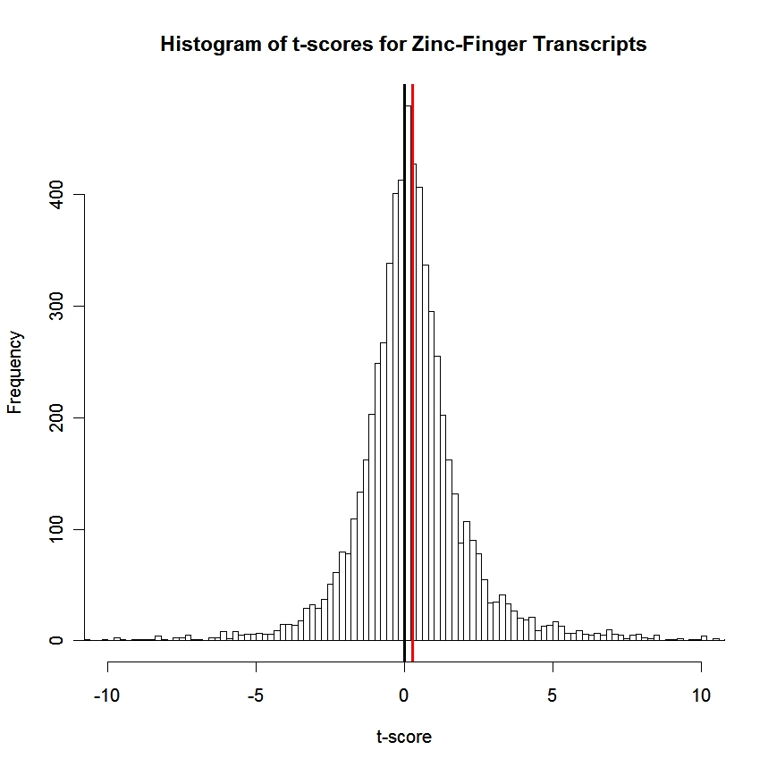

Slide 117
Patient | Direction | EPV
1 | Up | 0.125
2 | Down | 0.044
3 | Down | 0.001
4 | Up | 0.000
5 | Up | 0.003
6 | Up | 0.000
7 | Up | 0.000
8 | Up | 0.039
All | Up | 0.000

Slide 118
Major Advantages
More sensitive to weak or diffuse signals
Able to cope with inter-individual variability in response
Conclusions are solidly based statistically
Can use a variety of types of biological knowledge

Slide 119
Assessing Significance
For each gene set, hypergeometric = Fisher’s exact test.
Not robust to correlations.
Simple to implement
Requires specific cutoff
GSEA KS test is a generalization if used with the standard KS significance points
Must be adjusted (say, by FDR) if many gene sets are used.

Slide 120
Assessing Significance
Array permutation, compare significance of set to significance of same set under permutations.
If there are 12 control and 12 treatment arrays, then there are 2,704,156 ways to choose 12 arrays from the 24 without regard to treatment assignment. P-values can be down to 4×10⁻⁷.
Can only test the complete null if there is more than one factor.

Slide 121
Assessing Significance
Gene permutation can test any hypothesis.
Compare given gene set to random gene sets from the same set of arrays.
This tests if the given gene set is extreme from a random gene set.
Array permutation tests if a given gene set is surprising regardless of other gene sets.
These are different hypotheses, but both may be useful.

Slide 122
Exercise
Take the top 10 genes from the keratinocyte gene expression study and map their go annotations using AMIGO.
Are there any obvious common factors?
Do you think this would work better if you looked at all the significant genes and all the GO annotations, or would this be too difficult?

